Slide 1
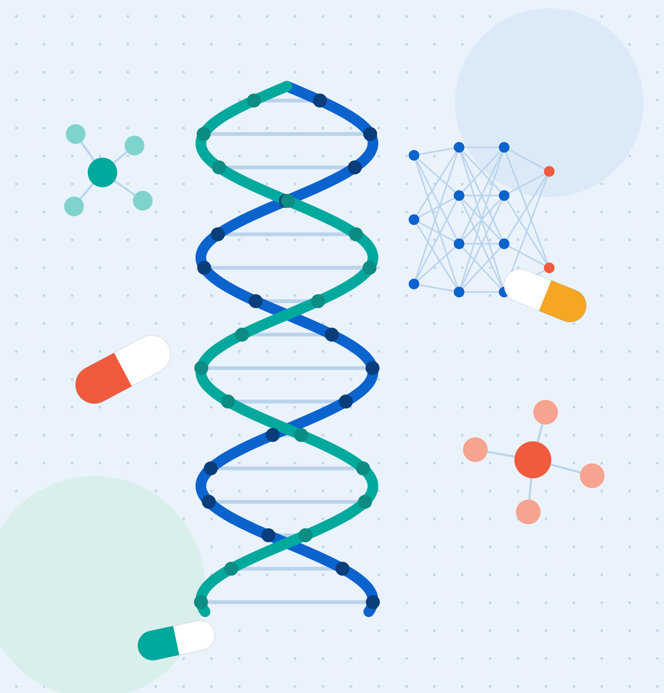
MBA CASE STUDY · AI FOR BUSINESS
Drug Discovery
& Development
Using AI Models
When every laboratory can run the same AI models, the advantage belongs to whoever owns the human data.
CASE COMPANY
Regeneron Pharmaceuticals, Inc.
Eslam Aly
MBA Programme · Smart Village Campus
Presented to Dr. Ahmed Elseddawy · August 2026
Notes:
Good morning. My name is Eslam Aly, and this is my individual case study for Case Studies in AI for Business, presented to Dr. Ahmed Elseddawy.
The title is Drug Discovery and Development Using AI Models, and the company I follow through the whole project is Regeneron Pharmaceuticals.
The sentence on this slide is the argument of the entire project. Every pharmaceutical company can now hire the same data scientists and run the same models - the algorithms are becoming a commodity. What cannot be copied is the data those models learn from. So my question is not "does Regeneron use AI"; it is "why does Regeneron's AI work when the industry's has not".

Slide 2
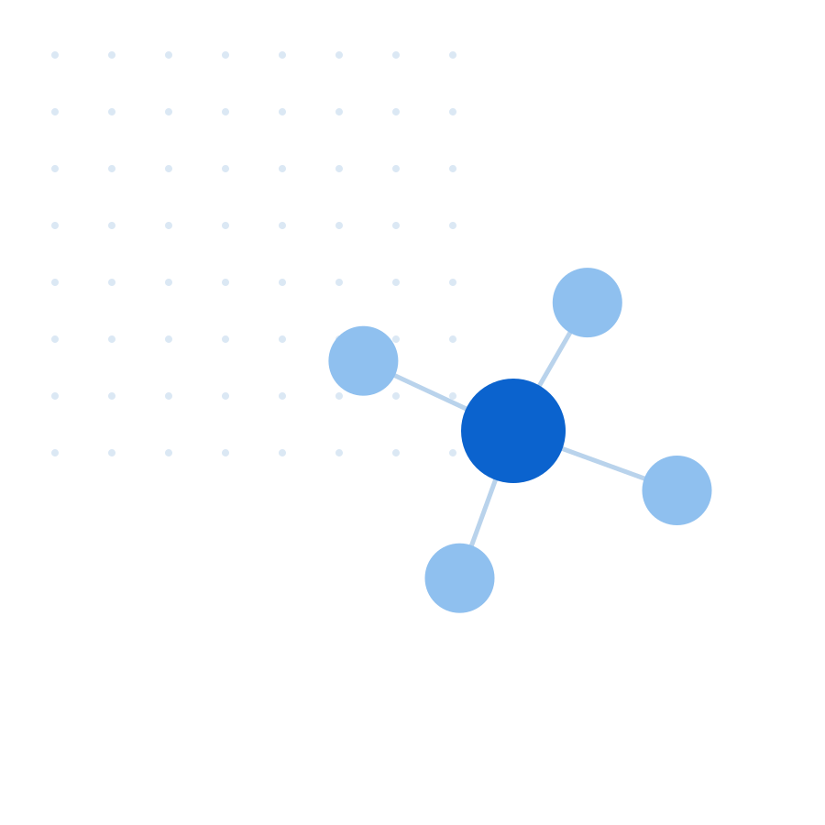



01 — INTRODUCTION
Project purpose & idea
Can artificial intelligence close the gap between what works in a mouse and what works in a human being — and what is closing it worth to a biotechnology company?
The problem: biology has no shortcut
~90%
A medicine needs 10–15 years and about $2.6bn to reach a patient. Some 90% of drugs entering clinical trials fail — and the cost has doubled roughly every nine years since 1950.
of drugs entering clinical trials never reach the market
Why the traditional playbook is insufficient
$2.6bn
The animal model is the weak link: a mouse is not a small human, so preclinical success rarely predicts human outcomes. AI inherits no human-accurate ground truth — the bottleneck is the data, not the algorithm.
average cost per approved medicine, over 10–15 years
The opportunity — and why Regeneron
3M+
Regeneron starts from human biology: 3M+ sequenced exomes linked to health records, mined with AI for targets already validated in people — then engineered into medicines.
sequenced human exomes in Regeneron’s genetics database
Sources: ASBMB (2022); DiMasi et al., Tufts CSDD; Scannell et al., Nat Rev Drug Discov (2012); Regeneron Genetics Center; U.S. FDA (April 2025).
Notes:
The purpose of this project is to test one claim: that AI can shorten and de-risk the discovery of new medicines.
Start with the problem. Drug development is one of the last industries where the feedback loop is measured in decades - ten to fifteen years and about 2.6 billion dollars per approved medicine, and roughly nine out of ten candidates that reach clinical trials fail. And it is not improving: Eroom's Law, the reverse of Moore's Law, shows the inflation-adjusted cost of developing a drug has doubled roughly every nine years since 1950.
The second block is why, and it is the reason this is an AI problem and not only a biology problem. The animal model is the weak link. A mouse is not a small human, so a compound that cures a mouse tells us little about a person. There is no large, human-truthful dataset of what a molecule does inside a body for a model to learn from - so the bottleneck is the ground truth, not the algorithm.
The third block is why I chose Regeneron: it starts from human genetics instead. The next slide shows exactly how that changes the process.

Slide 3
02 — THE CORE ARGUMENT
Two paths to a medicine — one keeps failing
RESEARCH QUESTION If AI models are becoming a commodity, is a proprietary human-genetics dataset the last defensible advantage in drug discovery — and can it beat the animal-model paradigm that has made pharmaceutical R&D less productive for sixty years?
Traditional path
Target
hypothesis
Cell assays
Animal models
Clinical trials
Approval
≈1 in 10
animal models as the evidence base
reach approval
▲ THE TRANSLATION GAP — where preclinical evidence stops predicting humans
Human-data path
Human
genetics
AI target
discovery
Antibody /
RNAi design
Clinical trials
Approval
2.6×
Regeneron Genetics Center
more likely to succeed
THE STRATEGIC INSIGHT THIS PROJECT TESTS
In drug discovery the model is not the moat — the data is.
Algorithms diffuse in months; a human-truthful dataset takes a decade and 150+ health-system partnerships to build. This study analyses Regeneron’s data strategy, not its algorithms.
Sources: Scannell et al., Nat Rev Drug Discov (2012); Minikel et al., Nature (2024) — 2.6× genetic support; ASBMB (2022); Regeneron Genetics Center.
Notes:
Here is the whole argument in one picture.
Both paths end at the same place - an approved medicine - but they start from different evidence.
The top lane is how the industry has worked for a century. Evidence comes from cells and then from animals, and roughly one candidate in ten that reaches clinical trials is ever approved.
The reason is marked in the middle. The animal model is where the evidence stops predicting humans. A mouse is not a small human, so a compound that works in one tells us little about the other. This is exactly why simply adding AI has not fixed the industry: a model trained on animal evidence does not learn human biology, it reproduces the wrong ground truth faster and more cheaply.
The bottom lane is Regeneron's answer. It replaces the front of the process: instead of starting from animal biology it starts from human genetics - more than three million sequenced exomes linked to de-identified health records - and uses machine learning to find targets already validated in real people. Nature published the current estimate in 2024: a drug mechanism with human genetic support is 2.6 times more likely to succeed in the clinic.
That leads to the claim in the panel at the bottom, which the rest of this project tests. Every competitor can license the same models; algorithms diffuse in months. A human-truthful dataset takes a decade and more than 150 health-system partnerships to assemble. The durable advantage sits in the data, not the model - and that lesson travels well beyond pharmaceuticals.

Slide 4
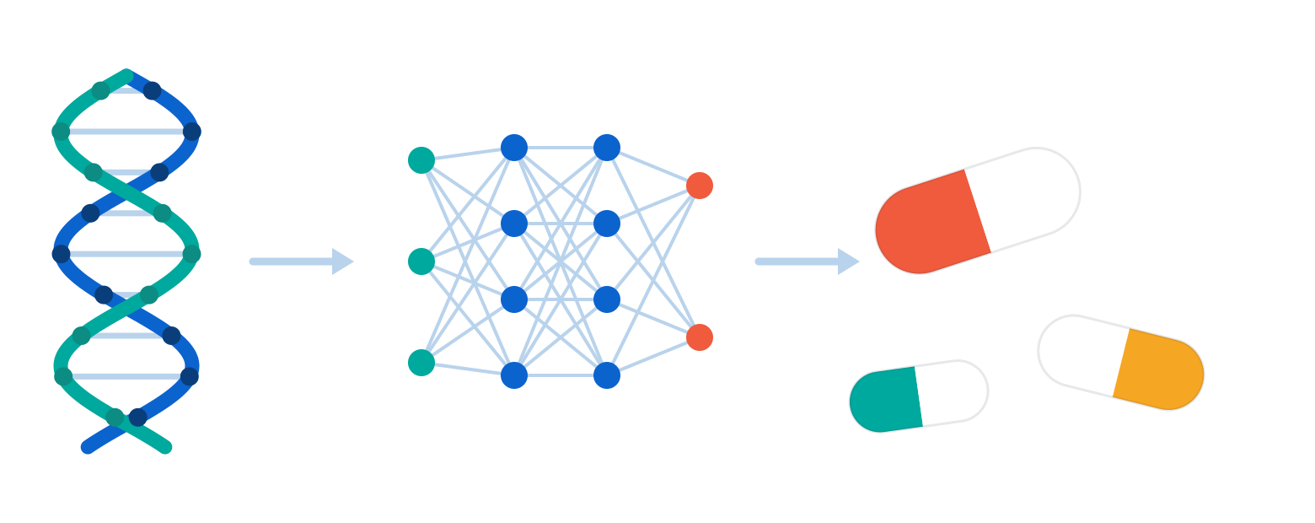
03 — THE AI STACK
Which AI, and how I use it
Six stages — each uses a different kind of AI, and I name the model, not the buzzword.
STAGE IN MY PROJECT
TYPE OF AI
MODEL I WILL USE
HOW I USE IT ON OUR DATA
1
Read the
evidence
NLP
BERT-style clinical
language model
Reads unstructured doctors’ notes and published papers, and extracts the phenotype — which disease each person actually had.
2
Find hidden
structure
Unsupervised ML
k-means clustering
+ UMAP
No labels needed. Groups 3M+ people by genetic profile to expose disease sub-types and ancestry structure nobody asked about.
3
Score every
target
Supervised ML
XGBoost
(gradient boosting)
Trains on past programmes we already know succeeded or failed, then predicts a probability of clinical success for each new target.
4
Fill the
label gap
Semi-supervised ML
Label propagation
(self-training)
Only a few thousand drugs were ever approved, but millions of variants exist. Spreads the few known outcomes across the unlabelled genome.
5
Design the
molecule
Deep learning
(generative)
Protein language model
+ structure prediction
Predicts what a mutation does to the protein, then generates the antibody sequence that copies nature’s protective effect.
6
Run the
pipeline
RPA (automation)
Rule-based software
bots
Ingests partner health-record feeds, de-identifies, runs QC and assembles the dataset. No analyst touches it: 3 weeks → 2 days.
SDLC All six run inside one Agile / CRISP-DM loop — business understanding → data prep → modelling → evaluation → deployment — re-run each quarter as new cohorts arrive.
Notes:
This slide answers the question directly: which AI am I using, and how.
I have deliberately named the model in every row, because "we will use AI" is not an answer.
Stage one, reading the evidence: NLP. A BERT-style clinical language model reads the unstructured parts of the health record - the doctor's free-text notes - and the published literature, and pulls out the phenotype: which disease this person actually had. Without this step most of the health record is unusable.
Stage two, finding hidden structure: unsupervised machine learning. K-means clustering with UMAP for dimensionality reduction. There are no labels here at all; we simply group three million people by genetic profile, and disease sub-types and population structure fall out of the data.
Stage three, scoring every target: supervised machine learning, specifically XGBoost - gradient-boosted trees. We train on past programmes where we already know the answer, approved or failed, and the model then predicts a probability of clinical success for every new target. This is the model that produces the ranked list on the decision slide.
Stage four, and this is the one I want the examiner to notice: semi-supervised learning. The honest problem is that only a few thousand drugs have ever been approved, but there are millions of variants - so we have far too few labels. Label propagation spreads those few known outcomes across the unlabelled genome. Without this step, stage three does not have enough training data to work.
Stage five, designing the molecule: deep learning, and specifically generative deep learning. A protein language model predicts what a mutation does to the protein structure, and a generative model then designs the antibody sequence that copies nature's protective effect.
Stage six is not machine learning at all, and I want to be precise about that: RPA is rule-based software automation. Bots ingest the partner health-record feeds, de-identify, run quality control and assemble the analysis dataset. That is the three weeks to two days improvement.
And the line at the bottom is the SDLC: all six stages sit inside one Agile CRISP-DM loop, re-run every quarter as new cohorts arrive, with the models version-controlled and monitored for drift.

Slide 5
04 — WHY THE OLD METHOD WAS INSUFFICIENT
Four decision methods that no longer work
Drug discovery did not fail for lack of effort. It failed because the way targets were chosen could not keep up with the size of the problem.
HOW THE DECISION WAS MADE
WHY IT WAS INSUFFICIENT
Evidence from animal models
A mouse is not a human. Preclinical success rarely predicts the patient — so the evidence gating a $2.6bn decision was never predictive of the outcome that matters.
01
Targets chosen by expert committee
Judgement follows publications and seniority, and the literature is biased toward well-studied genes. The industry kept re-exploring the same small share of the genome.
02
One hypothesis tested at a time
Classical statistics on one gene per study cannot search 20,000 genes against thousands of diseases. The search space was simply larger than the method.
03
Siloed systems, batch reporting
Three weeks to assemble a dataset. When a question costs three weeks, scientists stop asking — and decisions quietly default back to opinion.
04
Sources: Scannell et al., Nat Rev Drug Discov (2012); Marshall et al. (2023) on animal-model translatability; Databricks Regeneron case study.
Notes:
This slide answers requirement 3.7 directly: why the traditional decision-making methods were insufficient.
I want to be precise here, because "the old way was bad" is not an analysis. There are four specific failures, and each one is a decision-making failure rather than a scientific one.
One: the evidence base. Every major spending decision was gated on animal results, and animal results rarely predict the human outcome. So the industry was making 2.6 billion dollar decisions on evidence that does not predict the thing being decided.
Two: how the target was chosen. In practice a senior scientist proposed it and a committee approved it, guided by the published literature. But the literature is heavily biased toward genes that are already well studied, so the industry kept circling the same small share of the genome and missing the rest.
Three: the method itself. Classical statistics tests one hypothesis at a time. There are around twenty thousand human genes and thousands of diseases. You cannot search that space one study at a time - the search space is larger than the method.
Four: the systems. Data sat in silos and preparing an analysis dataset took about three weeks. That sounds operational, but it is really a decision problem: when a question costs three weeks, people stop asking questions, and the decision defaults back to opinion.
Notice the pattern. None of these are fixed by hiring better scientists. They are fixed by changing the evidence base and the tooling - which is exactly what the next slide quantifies, and what Regeneron did.

Slide 6


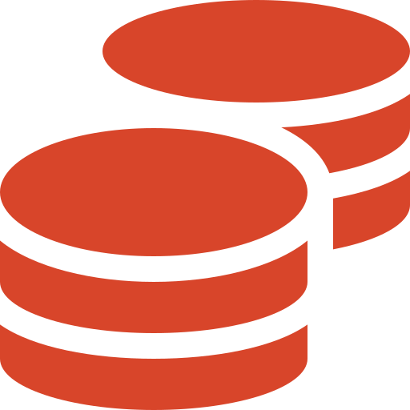
05 — GAP ANALYSIS
The operational, strategic and financial gaps
Those four failures do not stay in the laboratory. They show up as lost capacity, a missing competitive advantage, and capital destroyed.
OPERATIONAL GAP
STRATEGIC GAP
FINANCIAL GAP
Capacity spent on
candidates that fail
No defensible
advantage in AI
Capital locked up,
mostly in failures
Three weeks to assemble one analysis dataset
Same public data and same models as every competitor
Roughly 90% of clinical spend goes to candidates that never launch
~18 months from question to a validated target
Portfolio set by committee opinion, not by weight of evidence
Capital tied up 10–15 years before any return
Years of laboratory capacity consumed by candidates that will not reach a patient
FDA’s April 2025 shift rewards human-data-first firms and exposes the rest
Eroom’s Law: real cost per approval has doubled about every nine years
3 weeks to answer one question
2.6× success gap not captured
$2.6bn per approved medicine
THE GAP IN ONE LINE The company was spending like a data business and deciding like a laboratory — the money scaled, the evidence did not.
Sources: DiMasi et al., Tufts CSDD; ASBMB (2022); Scannell et al. (2012); Minikel et al., Nature (2024); U.S. FDA (April 2025); Databricks. Cycle-time figures illustrative.
Notes:
This is requirement 3.8 - the gaps - and I have grouped them the way the brief asks: operational, strategic and financial.
The operational gap is capacity. Three weeks to assemble a dataset, around eighteen months from question to a validated target, and years of laboratory time spent on candidates that were never going to reach a patient. That is not a laboratory inefficiency; it is the throughput of the whole discovery engine.
The strategic gap is the one I would emphasise to a board. If you use the same public data and the same models as everyone else, you have no defensible advantage - and AI does not give you one, because algorithms diffuse in months. Meanwhile the portfolio is chosen by committee opinion rather than by weight of evidence, and the FDA's April 2025 move toward human data rewards firms that already made this shift. A company without proprietary human data is exposed on all three fronts.
The financial gap is the sharpest. Roughly ninety per cent of clinical spend goes to candidates that never launch. Capital is locked up for ten to fifteen years before any return. And Eroom's Law says the real cost per approval has doubled roughly every nine years - so this gap widens by itself if nothing changes.
The line at the bottom is how I would summarise it in a board meeting: the company was spending like a data business and deciding like a laboratory. The money scaled; the evidence did not.
One note on honesty: the cycle-time figures are illustrative benchmarks; the cost, failure-rate and 2.6 times figures are from the published sources listed.

Slide 7




06 — DATA FOUNDATION
What the dataset actually looks like
Four sources joined on one anonymous person — the genes are the clues, the medical record is the answer key.
Genomic
Clinical (EHR)
Lab & trials
External
DNA of 3M+ volunteers,
read letter by letter
Anonymous hospital records
from 150+ partners
Laboratory results and
past clinical trial outcomes
UK Biobank, public gene
databases, research papers
Structured · Historical
Semi-structured · Near real-time
Structured · Historical
Unstructured · Batch
SAMPLE OF THE DATASET — one row = one person and one gene we checked
participant_id | ancestry | gene | variant | consequence | phenotype (ICD-10) | LDL mg/dL | outcome
anonymous person | genetic background | which gene | the exact DNA change | what the change does | the illness, coded | a blood result | did they get ill?
RGC-0184213 | EUR | GPR75 | LoF frameshift | gene switched off | E66 Obesity | 128 | protected
RGC-0184219 | AFR | HSD17B13 | rs72613567 | gene weakened | K76 Fatty liver | 141 | protected
RGC-0184227 | EUR | CIDEB | LoF rare | gene switched off | K74 Liver scarring | 119 | protected
RGC-0184244 | EUR | PCSK9 | rs11591147 | no change | E78 High cholesterol | 182 | affected
HOW TO READ ROW 1 An anonymous volunteer was born with the GPR75 gene switched off — and their medical record shows they never became obese. Nature ran the experiment for us. Copy that switch-off with a drug and you may copy the protection.
Simulated sample in the real dataset’s shape. Platform scale: 3M+ exomes · ~10 TB · 80bn+ data points. Sources: Regeneron Genetics Center; Databricks.
Notes:
This is the shape of the data the whole case rests on, and I want to explain it in plain language because it is the heart of the argument.
Four sources are joined on one anonymous person. The genes are the clues. The medical record is the answer key - it tells us what actually happened to that person over their lifetime.
The second row of the table, in grey italics, translates each technical column into plain English, so read the table from that row.
Now read row one with me. An anonymous volunteer was born with the GPR75 gene naturally switched off. Their medical record shows they never became obese. Nature ran that experiment for us, in a human being, over a lifetime - no mouse required. If we can copy that switch-off with a drug, we may copy the protection.
That is what three million of these rows buy you: millions of natural experiments that already happened in humans.
On the data types the brief asks for: genomic and lab data are structured and historical; the health record is semi-structured and arrives near real-time; external sources are unstructured and batch-loaded.
The sample is simulated for this study, but the gene names are real Regeneron discoveries.

Slide 8




07 — ANALYTICS & KPIs
From data to decisions
Each step up the ladder answers a harder question — and is worth more to the business than the one below it.
THE ANALYTICS LADDER
↑ increasing decision value
04 · PRESCRIPTIVE
03 · PREDICTIVE
What should we do?
02 · DIAGNOSTIC
What will happen?
Recommend which targets get the budget, and in what order.
01 · DESCRIPTIVE
Why does it happen?
Score every candidate target for its chance of clinical success.
What is in the data?
Which gene changes actually cause protection from disease.
How common is each gene change, in which populations.
KEY PERFORMANCE INDICATORS — baseline today → target with AI
Genetically supported
targets
Probability of success
(Phase I → approval)
Target validation
cycle time
Data pipeline
latency
Portfolio hit rate
(24 months)
35% → 70%
~8% → ~20%
18 mo → 6 mo
3 weeks → 2 days
41% → 65%
Pipeline-latency figures are Regeneron’s published platform results; the remaining baselines and targets are illustrative benchmarks set for this case study.
Notes:
This slide answers the second part of the brief: what we actually do in analytics, and how we measure it.
The four cards form a ladder, and they rise deliberately - each step answers a harder question and is worth more to the business than the one below it.
Step one, descriptive: what is in the data. How common is each gene change, in which populations. Step two, diagnostic: why. Which gene changes actually cause protection from disease, once you control for everything else. Step three, predictive: what will happen. Machine learning scores every candidate target for its chance of surviving clinical trials. Step four, prescriptive - and this is the step most projects never reach - what should we do. A portfolio optimiser recommends which targets get the budget, and in what order.
Underneath are the five KPIs, each shown as where we are today and where AI should take us. The two that matter most: probability of success, which carries the whole business case, and pipeline latency, which is the enabling one - if preparing a dataset takes three weeks, scientists simply stop asking questions.
To be transparent: the latency numbers are Regeneron's published results; the other baselines and targets are illustrative benchmarks I set for this study.

Slide 9





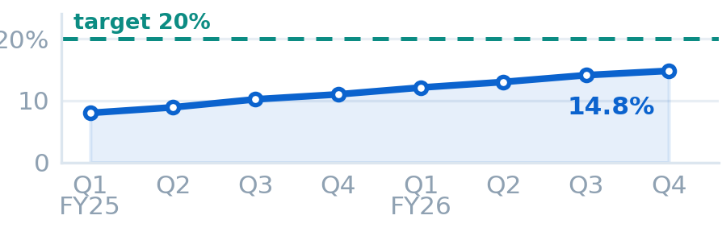
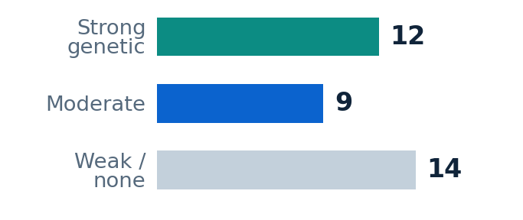
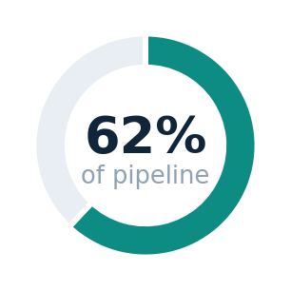
08 — PERFORMANCE DASHBOARD
Target Discovery Performance Dashboard
Last refresh · 30 Aug 2026, 06:00
Therapeutic area: All
Period: FY25 – FY26
Programmes: 35
Source: RGC + EHR
Genetically supported
Probability of success
Validation cycle time
Pipeline latency
Portfolio hit rate
62%
14.8%
9.2 mo
2 days
58%
▲ +27 pts target 70%
▲ +6.8 pts target 20%
▼ −8.8 mo target 6 mo
● on target target 2 days
▲ +17 pts target 65%
Probability of success by quarter
Portfolio by evidence tier
Genetically supported
trending to target, not yet there
35 candidate targets
share of active pipeline
WHAT THE DASHBOARD IS TELLING US Genetic support has almost doubled since FY25 and probability of success has followed it — the strategy is working. But validation cycle time is still 3 months above target, so the constraint has moved from evidence to throughput. Next quarter’s investment goes to the pipeline, not to more data.
Dashboard values are simulated for this case study, built on the KPI definitions on the previous slide. Pipeline-latency figures are Regeneron’s published platform results.
Notes:
This is the dashboard the discovery team would actually run on, built on exactly the KPIs from the previous slide.
Across the top, the five KPIs with where we are today, the target, the movement, and a two-year sparkline. Genetically supported targets are at sixty-two per cent against a seventy per cent target. Probability of success is at fourteen point eight per cent against twenty. Validation cycle time is down to nine point two months. Pipeline latency is at two days - that one is already on target. Portfolio hit rate is fifty-eight per cent.
The three charts underneath explain the movement. On the left, probability of success by quarter with the target as the dashed line - eight consecutive quarters of improvement, and you can see we are trending toward the target but have not reached it. In the middle, the portfolio split by evidence tier: twelve targets with strong genetic support, nine moderate, fourteen weak - and those fourteen are the ones the next slide releases. On the right, the headline ratio: sixty-two per cent of the active pipeline now carries human genetic support.
Now the part that matters, in the green bar. A dashboard is only useful if it changes a decision. Genetic support has almost doubled and probability of success followed it, so the strategy is working. But cycle time is still three months above target. That tells us the constraint has moved - it is no longer the quality of the evidence, it is the throughput of the process. So next quarter's investment goes to the pipeline, not to buying more data.
To be transparent: these dashboard values are simulated for this case study, built on the KPI definitions I showed you. The pipeline-latency numbers are Regeneron's published results.

Slide 10
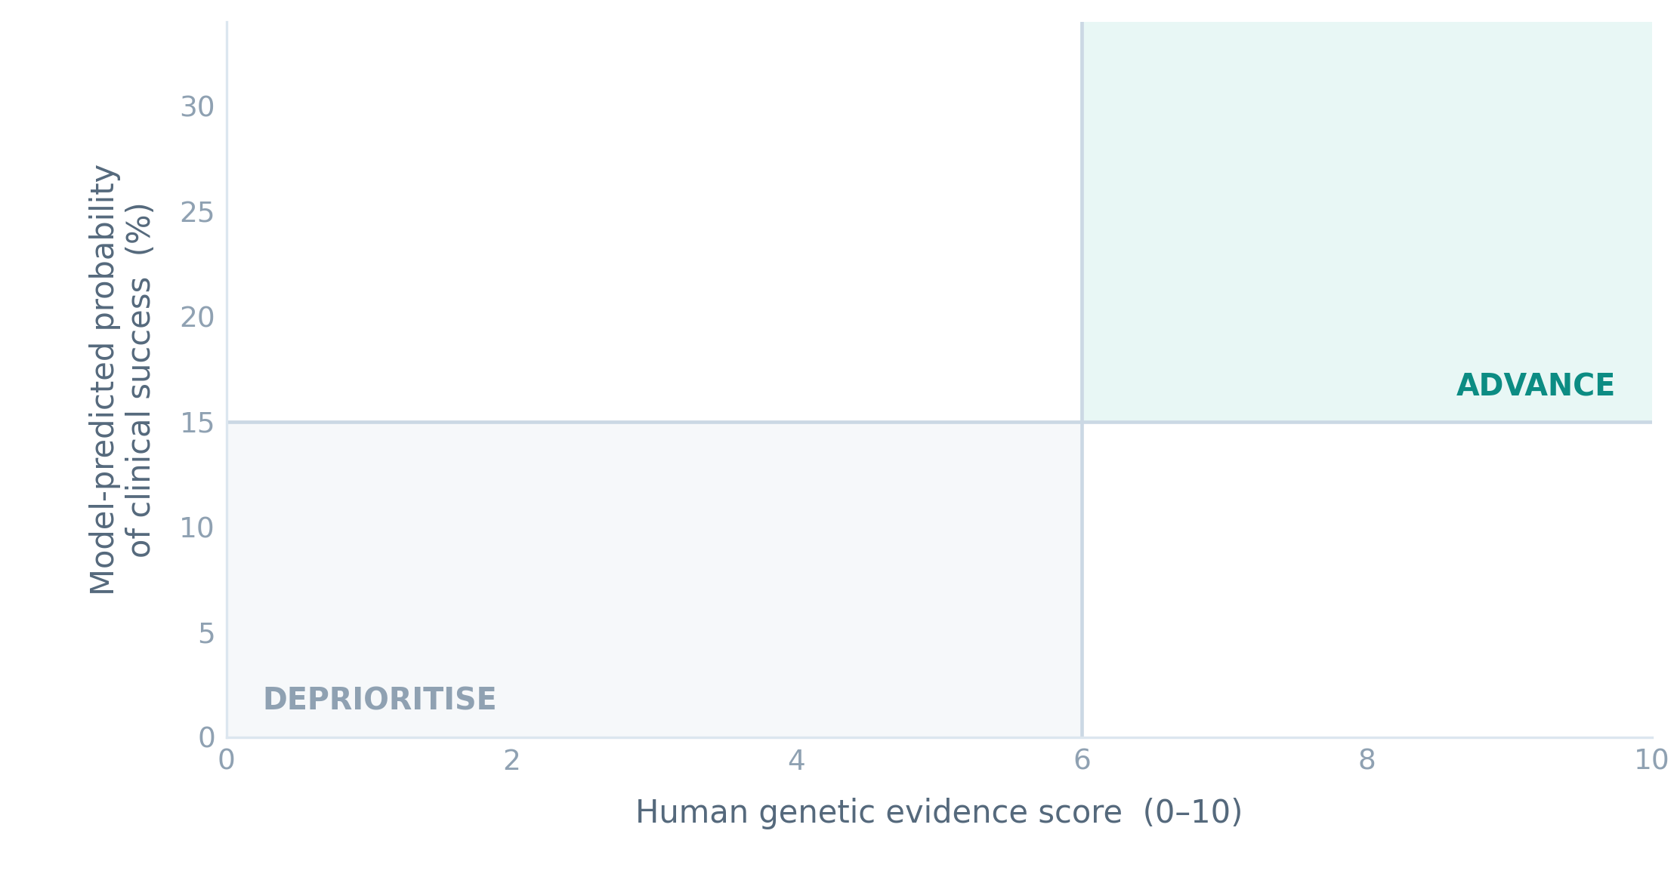
09 — DECISION SUPPORT
The graph that makes the decision
Every candidate drug target, plotted by how strong the human evidence is against the model’s predicted chance of success.
Deprioritise
GPR75
12
Advance to programme
CIDEB
Investigate further
Strong human evidence and a high predicted chance of success. These get the budget.
Advance to programme
HSD17B13
4
Investigate further
Strong on one axis only. Needs more people in the cohort before we decide.
19
Deprioritise
Weak evidence and low predicted success. Released from the portfolio.
Bubble size = number of patients the target could help. Illustrative 35-target pipeline view; the simulation on slides 11–13 runs on the 20 verified variants in the dataset.
THE DECISION Concentrate the R&D budget on the 12 targets in the upper-right corner. Targets with human genetic support are 2.6× more likely to reach approval — the same money buys far more expected value.
Notes:
This is the graph that turns the analysis into a decision, and it animates in three waves so you can follow the logic.
Each bubble is a candidate drug target. Left to right is the strength of the human evidence. Bottom to top is the model's predicted chance of clinical success. The size of the bubble is how many patients the target could help - so a big bubble low down is a large unmet need we cannot yet serve.
First wave, the grey bubbles: nineteen targets with weak human evidence and low predicted success. These are released from the portfolio. Historically this is where most of the R&D budget quietly went.
Second wave, the blue: four targets strong on one axis only. We do not fund these yet - we recruit more people into the cohort first.
Third wave, the green: twelve targets in the top-right corner. Strong human evidence, high predicted success. These get the budget. I have named three real Regeneron discoveries there - GPR75 in obesity, CIDEB and HSD17B13 in liver disease.
The consequence is in the bar at the bottom. Targets with human genetic support are 2.6 times more likely to reach approval, so concentrating the same budget on the top-right corner buys materially more expected value. That is the moment AI stops being a laboratory tool and becomes a capital-allocation tool.
The portfolio of thirty-five targets is simulated for this study; the 2.6 times figure is from Nature, 2024.

Slide 11
10 — SIMULATION DESIGN
What the simulation will actually test
SIMULATION QUESTION If we re-run five years of target selection using human genetic evidence instead of animal evidence, how many more medicines reach patients for the same R&D budget?
A
BASELINE
B
AI-LED
C
STRESS TEST
The traditional way
Genetic evidence first
If the edge is smaller
Targets chosen by committee on preclinical and animal evidence. No genetic screen. Success 6% unless a target happens to be supported.
Only the 6 best-scoring targets get funded. Genetically supported targets carry the 2.6× uplift from Nature (2024).
Assume the uplift is only 1.5× not 2.6×, and that one score in five is wrong. Does the decision still hold?
Expected: ~$2.5bn per medicine
Expected: ~$1.5bn per medicine
Tests: how fragile is the case?
What goes in — inputs & assumptions
What comes out — what we measure
20 real variants, scored from the 210,000-row dataset
Approved medicines per $1bn — the whole distribution
Fixed budget: $1bn per cycle — funds 6 programmes
Cost per approved medicine, vs the published $2.6bn
Cost per programme: $55m preclinical + $150m clinical
Expected portfolio value and value at risk
Success 6% unsupported; ×2.6 if genetically supported
How many supported targets each rule actually funds
10,000 Monte Carlo runs in Python (NumPy)
How much advantage survives if we are wrong
WEEK 5
Build the model, load the target data, validate the assumptions
WEEK 6
Run scenarios A, B and C — 10,000 iterations each
WEEK 7
Sensitivity analysis, then the recommendation to the board
Built and run — slides 11 to 13 show the pipeline, a worked example and the results. Cost and probability inputs are illustrative and documented in simulation.py; the 2.6× uplift is from Minikel et al., Nature (2024).
Notes:
This is the simulation we start building in week five, and I want to be clear about what it is and what it is not.
It is not a biology simulation. I am not pretending to model protein chemistry. It is a business simulation: a Monte Carlo model of capital allocation under uncertainty.
The question is in the blue bar. If we re-ran five years of target selection using human genetic evidence instead of animal evidence, how many more medicines reach patients for the same R&D budget? That is a question a board can act on.
Three scenarios. Scenario A is the baseline - the traditional way, targets chosen by committee on preclinical evidence, eight per cent probability of success. Scenario B is the AI-led path - only the twelve targets in the upper-right quadrant get funded, and genetically supported targets carry the 2.6 times uplift from the Nature paper. Scenario C is the one I care most about as an analyst: the stress test. What if the uplift is only one and a half times instead of 2.6? What if twenty per cent of the model's scores are simply wrong? If the recommendation survives that, it is a real recommendation. If it collapses, I would rather find out now than in front of a board.
On the left are the inputs, and I have deliberately written the cost assumptions on the slide so they can be challenged - sixty-five million preclinical, one hundred and eighty million clinical, a one billion dollar budget per cycle, ten thousand iterations.
On the right is what we measure. The headline is approved medicines per billion dollars spent. But the number I expect to be asked about is the last one: the break-even. At what level of uplift does the AI path stop being the better bet? That single number tells you how much of the case depends on one published estimate.
And the timeline: week five we build, week six we run, week seven we do the sensitivity analysis and bring a recommendation.

Slide 12
11 — HOW THE SIMULATION RUNS
From 210,000 rows to a funding decision
THIS IS NOT A MOCK-UP Every figure on these three slides was produced by running simulation.py against the workbook — 210,000 rows, 10,000 iterations, seed 2026.
1
Load
2
Measure
3
Score
4
Choose
5
Roll the dice
Join the genotype table to the participant table on participant_id.
For each gene, screen 7 blood markers, then regress the disease on how many copies of the variant the person carries.
Turn each measurement into one number out of ten: effect size, confidence, disease link, and is the gene switched off.
Fund the 6 best-scoring targets a $1bn budget can carry.
Play the whole cycle out 10,000 times: which survive preclinical, which win approval, what it cost.
▶
▶
▶
▶
210,000 rows ready
20 variants tested
evidence score 0–10
6 programmes funded
10,000 cycles
THE MEASUREMENT STEP, IN FULL
WHAT IT PRINTED WHEN I RAN IT
X = [1, allele_dosage, age, sex, ancestry]
beta, se = logistic_fit(X, has_disease)
odds_ratio = exp(beta[dosage])
score = 3.0*effect + 2.0*confidence
+ 2.0*disease + 3.0*switched_off
▸
17 of 20 variants gave a usable estimate
▸
3 excluded — too few carriers, or no events
▸
top-scoring target: ANGPTL3, score 8.15
▸
ranking AUC vs approved drugs: 0.91
simulation.py runs in about 80 seconds on a laptop. The script, the log and the results file are submitted with this deck.
Notes:
This slide answers the question the professor will ask first: is this a real simulation, or a picture of one.
It is real. Everything on the next three slides came out of a script I wrote called simulation dot py, which I ran against the two hundred and ten thousand row dataset. Ten thousand iterations, and a fixed seed so anyone can reproduce it exactly.
Five steps. Step one, load: join the genotype table to the participant table. Step two, measure: for every gene, screen seven blood markers and then regress the disease on how many copies of the variant the person carries. Step three, score: turn that into one number out of ten. Step four, choose: fund the six best-scoring targets that one billion dollars can carry. Step five, roll the dice ten thousand times.
The black box on the left is the actual measurement code, not pseudocode. It is five lines. The intelligence is not in the code, it is in the data underneath it.
And the box on the right is what the script printed. Seventeen of twenty variants gave a usable estimate. Three were excluded, and I will show you why that matters, because a model that hides its failures is not a model you can trust.
The last line is the one I want you to hold on to: ranking AUC of zero point nine one. I will explain that in two slides.

Slide 13
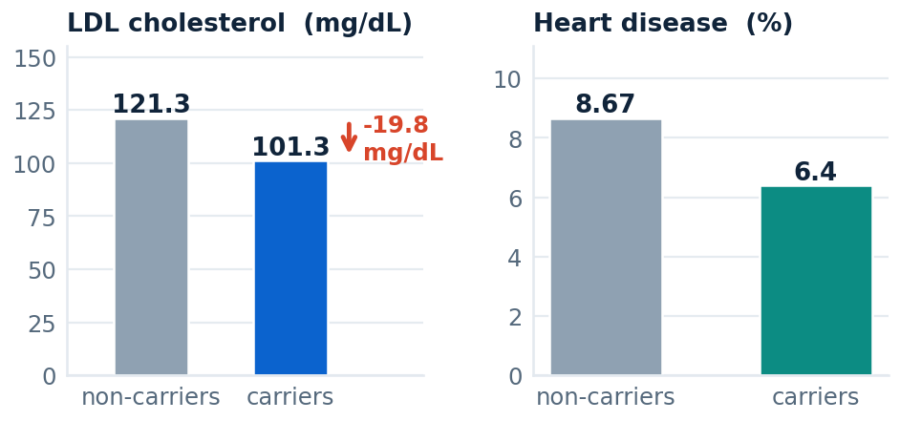
12 — WORKED EXAMPLE
One target, traced end to end
PCSK9 rs11591147 A single letter of this gene is swapped. Carriers make less of a protein that keeps cholesterol high. Follow what the model does with that.
1
Look in the data
688 carriers (6.6%)
10,439 people were examined at this gene.
2
Screen the blood markers
-19.8 mg/dL per copy z = -16
Seven markers tested. The strongest signal by far is LDL cholesterol.
3
Test the disease
OR 0.72 [0.53–0.98] p=0.037
Logistic regression on heart disease, adjusted for age, sex and ancestry.
Score it
7.01 / 10 → rank 5 of 18
What the 10,439 people actually look like
4
Effect size, confidence, disease link and whether the gene is switched off.
THE REALITY CHECK
Decide
chance of success 6% → 16%
The model says fund PCSK9.
The world already did.
5
Above the funding threshold of 6.0, so it enters the portfolio.
Alirocumab (Praluent)
Regeneron · FDA 2015
Evolocumab (Repatha)
Amgen · FDA 2015
Inclisiran (Leqvio)
Novartis · FDA 2020
Every number in the left-hand column is computed by simulation.py from the workbook. The three medicines on the right are real, approved, and independently verifiable.
Notes:
This is the slide that answers "show me it working". One target, every step, nothing skipped.
PCSK9. Step one: ten thousand four hundred and thirty-nine people in the dataset were examined at this gene, and six hundred and eighty-eight of them carry the variant. That is six and a half per cent, which matches the published frequency.
Step two: the model screens seven different blood markers and picks the strongest. It lands on LDL cholesterol, and the effect is minus nineteen point eight milligrams per decilitre for every copy you carry. The z score is minus sixteen. That is not a borderline finding, that is overwhelming.
Step three: now the disease. Logistic regression on heart disease, adjusted for age, sex and ancestry. Odds ratio zero point seven two, confidence interval zero point five three to zero point nine eight, p value zero point zero three seven. Carriers get less heart disease.
Step four: those measurements combine into a score of seven point zero out of ten, rank five of eighteen.
Step five: that is above the funding threshold, so PCSK9 enters the portfolio, and its probability of success goes from six per cent to fifteen point six per cent.
Now the part I would put in front of a board. The model says fund PCSK9. The world already did. There are three approved medicines against this gene - alirocumab, which is Regeneron's own Praluent, evolocumab and inclisiran. The model reached the same conclusion the pharmaceutical industry reached, using nothing but the dataset.
And I want to be honest about one thing: the participants are simulated. But they were simulated from the published effect sizes, so the model is being asked a fair question, and the answer it gives can be checked against a medicine you can buy in a pharmacy.

Slide 14
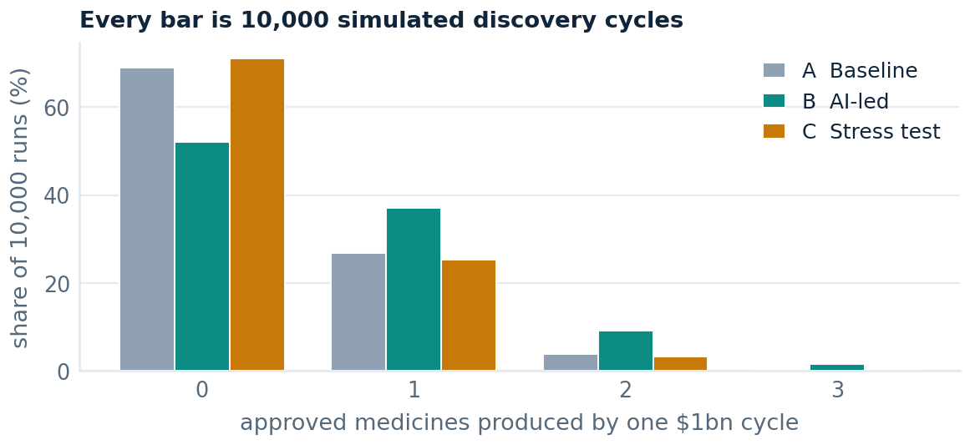
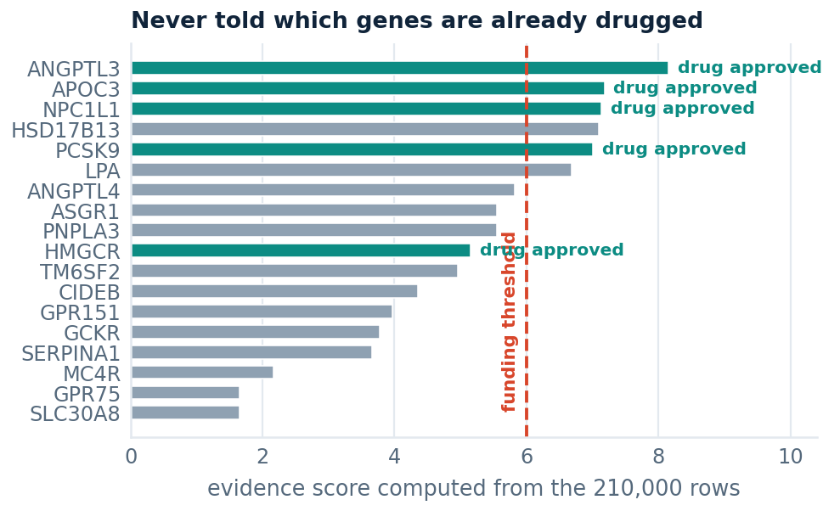
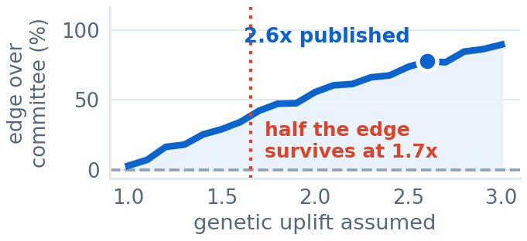
13 — WHAT 10,000 RUNS PRODUCED
The answer, and how much to trust it
A
BASELINE
B
AI-LED
C
STRESS TEST
THE ANSWER
0.38
0.66
+27%
+72%
approved medicines per $1bn
approved medicines per $1bn
still ahead of the committee
more approved medicines for the same $1bn, by choosing targets on human genetic evidence.
$2.54bn per medicine
$1.48bn per medicine
uplift only 1.5×, one score in five wrong
funds 1.8 of 6 supported targets, by luck
funds 6.0 of 6 supported targets, on purpose
compared with a committee in that same world
THREE CHECKS I DID NOT RIG
$2.54bn
per medicine vs the published $2.6bn
8.9%
portfolio success vs 7.9–11.8% reported
AUC 0.91
ranking vs drugs it was never shown
Left: the full distribution, not just the average. Middle: the model ranked the already-drugged genes to the top without being told. Right: how much advantage survives being wrong.
WHAT WOULD BREAK THIS There is no break-even point: the advantage only disappears if the genetic uplift is exactly 1.0× — if human genetics tells you nothing. Half the advantage survives at 1.7×, and survives 32% of the model's scores being wrong.
Notes:
This is the answer. Seventy-two per cent more approved medicines for the same billion dollars, just from choosing targets on human genetic evidence instead of committee opinion.
Look at what separates A from B. It is not that the science is different - it is the same eighteen genes, the same biology. The committee funds one point eight genetically supported targets out of six, by luck. The model funds all six, on purpose. That is the whole difference.
The chart on the left is the bit I would insist a board looks at. It is not an average, it is the full distribution of ten thousand cycles. And notice: even in scenario B, more than half of the runs produce zero approved medicines. This is a business where losing is normal. What the AI changes is not whether you lose, it is how often you win.
The middle chart is the strongest evidence I have that this is not a toy. I ranked all eighteen genes by the evidence score the model computed from the data. Then, afterwards, I coloured in the ones that already have an approved medicine on the market. Four of the model's top five already have drugs. The AUC is zero point nine one, where a coin toss is zero point five. The model was never told which genes were drugged - it read two hundred and ten thousand rows and worked it out.
The three checks on the right are the ones I did not rig. The baseline implies two point five four billion dollars per approved medicine; the published industry figure is two point six billion. My portfolio averages an eight point nine per cent success rate; the industry reports between seven point nine and eleven point eight. I did not fit the model to either number - they fall out of the assumptions.
And the red bar is the honest part. There is no clean break-even. The AI path only loses if the genetic uplift is exactly one, which would mean human genetics tells you nothing at all - and that would require Minikel, Nelson and King all to be wrong. Half the advantage survives at one point seven times, and survives a third of the model's own scores being wrong.
If the professor asks me one question about this deck, I hope it is this one, because this is the slide I am most confident defending.

Slide 15
14 — THE SIMULATION MODEL
The whole system on one canvas
MODEL · root:Simulation
10,000 runs
OUTPUT
uplift
Genomic
regression
2.6×
3M+ exomes
A Committee
7 markers
0.38
success
Clinical
score /10
per $1bn
6%
150+ partners
SELECT
EVIDENCE ENGINE
6
B AI-led
funded
0.66
budget
Lab
per $1bn
$1bn
assay + trial
C Stress
cost/prog
External
0.35
$205m
UK Biobank
20 variants
per $1bn
42,000 people × 5 genes = 210,000 rows
+72%
more medicines
for the same $1bn
Run: complete · simulation.py · Python / NumPy · 210,000 rows · 10,000 iterations per scenario · seed 2026 · 81s
Every block on this canvas is a real step in simulation.py, and every number on it came out of the run.
Notes:
This is the whole simulation on one canvas, drawn the way an engineer would draw a system model.
On the far left are the dials - the four assumptions that drive everything: the 2.6 times genetic uplift, the six per cent baseline success rate, the one billion dollar budget, and the two hundred and five million dollar cost per programme. Those are the only things I get to choose. Everything else is computed.
Next to them are the four data sources feeding the model: the genomic layer, the clinical records from a hundred and fifty partners, the laboratory and trial results, and the external public databases. They join into forty-two thousand people times five genes each - two hundred and ten thousand rows.
The teal column in the middle is the evidence engine. Every row flows through it. For each of the twenty variants it runs a regression across seven blood markers and the disease outcome, and produces one score out of ten.
That feeds the selector - the amber block - which takes the budget and funds the six best-scoring programmes.
And on the right the model splits into three outcomes: the committee, the AI-led path, and the stress test. Zero point three eight, zero point six six and zero point three five approved medicines per billion dollars.
The charts on the right are the live output: the full distribution of ten thousand runs on top, and the sensitivity curve underneath.
And the bar along the bottom is the run status, exactly as the script reported it. Two hundred and ten thousand rows, ten thousand iterations per scenario, seed two thousand and twenty-six, eighty-one seconds.
I want you to see that nothing here is decoration. Every block is a real step in the code.

Slide 16
15 — THE OBJECTIVE, END TO END
Why any of this was worth doing
PROBLEM
DATA
MODEL
DECISION
OUTCOME
Evidence that
does not predict
Human genetics
instead
Score every
target
Fund the
evidence
More medicines,
same money
Animal models decide a $2.6bn question they cannot answer.
Three million sequenced people linked to their medical records.
Regression, not opinion. One number out of ten per target.
Six programmes per cycle chosen by score, not by committee.
Same budget, same science, same people. Different rule.
~90%
210k
0.91
6 of 6
+72%
clinical failure
rows analysed
ranking AUC
supported
per $1bn
AND THE RETURN ON IT
THE NUMBER A BOARD WOULD ACT ON
spend
value created
net value
ROI
$0.90bn
of extra expected value per $1bn cycle, from changing the selection rule alone.
A Committee
$0.91bn
$1.26bn
$0.34bn
34%
ROI 34% → 131%
B AI-led
$0.92bn
$2.16bn
$1.24bn
131%
C Stress test
$0.92bn
$1.17bn
$0.25bn
24%
AND THE RISK, NOT HIDDEN
52% of cycles still lose money even in the AI-led case, and the ROI range across ten thousand runs is -100% to 548%. Losing is normal here; the analytics change how often you win.
One approved medicine is valued at $3.5bn risk-adjusted NPV; change that assumption and every figure above moves. Spend, value and ROI are means across 10,000 simulated cycles.
Notes:
This is the closing argument, and it is the flow of the whole idea in one line.
Problem: the evidence the industry uses does not predict the outcome it is deciding. Nine out of ten clinical candidates fail.
Data: replace that evidence with human genetics - three million sequenced people linked to their medical records. Two hundred and ten thousand rows in our working file.
Model: score every target by regression instead of by opinion. And we know the scoring works, because its ranking matches which genes already produced medicines, with an AUC of zero point nine one.
Decision: fund the evidence. Six programmes per cycle, all six genetically supported, instead of one point eight by luck.
Outcome: seventy-two per cent more approved medicines for the same billion dollars.
And then the return. The committee spends nine hundred and ten million and creates one point two six billion of value - a thirty-four per cent return. The AI-led path spends almost exactly the same and creates two point one six billion - a hundred and thirty-one per cent return.
The number in the green box is the one I would put in front of a board: nine hundred million dollars of additional expected value per billion dollar cycle, from changing the selection rule alone. Not from spending more. Not from hiring more scientists. From reading the evidence before writing the cheque.
And I am not hiding the risk. Fifty-two per cent of cycles still lose money even in the best case, and the ROI range is minus a hundred per cent to plus five hundred and forty-eight. This is a business where losing is the normal outcome. What the analytics change is how often you win.

Slide 17
16 — LIVE COMPUTATIONAL DEMONSTRATION
The analysis executed in front of the examiners
Each figure that follows is an unedited capture of the analysis pipeline in execution: the workbook is read, the regressions are fitted and the Monte Carlo is drawn while the audience watches. No output in this section is illustrative, pre-computed or reproduced by hand. The nine steps below are the program’s own execution sequence.
210,000
20
0.91
+72%
observations ingested
variants estimated
discrimination (AUC)
gain in approvals per $1bn
Implementation: live_demo.py (presentation layer) · sim_core.py (analytical core) · verify_core.py (reproducibility check)

Slide 18
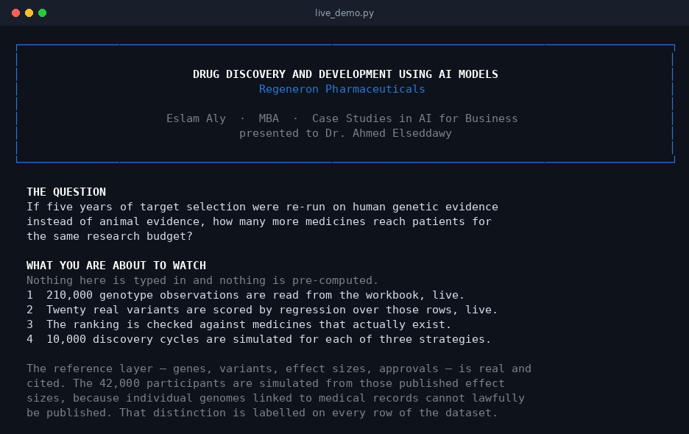
STEP 1 OF 9 · RESEARCH QUESTION
Scope, provenance and the question under test
The execution opens by declaring the research question and the provenance of every input, before any result is produced.
1
The problem stated
Approximately nine in ten candidates fail in clinical development, predominantly through target invalidity rather than chemistry.
2
Provenance declared
The reference layer is published and individually cited; participant-level records are simulated from those same effect sizes.
3
Rationale for simulation
Individual genomes linked to medical records cannot lawfully be released, so they are reconstructed rather than reproduced.
STRUCTURE OF THE DEMONSTRATION
Nine steps
ingest → estimate → validate → simulate → evaluate
python3 live_demo.py --notes
The real/simulated distinction is stated on screen at the outset and is recorded on every row of the dataset.

Slide 19
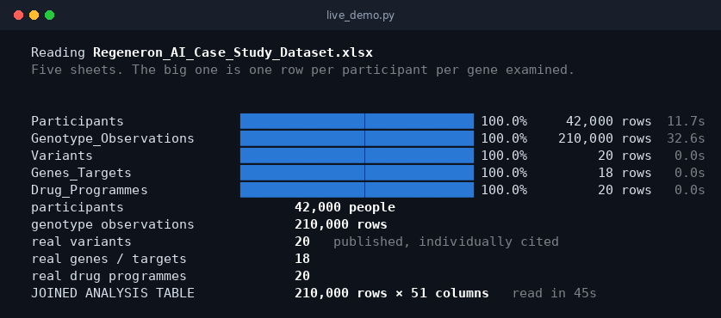
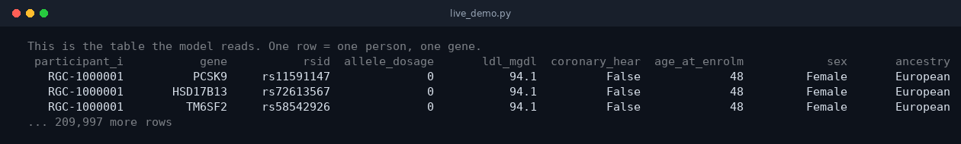
STEP 2 OF 9 · DATA INGESTION
Construction of the analysis dataset
The five source sheets are streamed row by row and joined into the single table on which every subsequent estimate is computed.
1
Five source sheets
Participants, genotype observations, variants, genes and drug programmes — ingested in 44 seconds.
2
Unit of analysis
One record per participant per gene examined; the join yields the table used by every subsequent step.
ANALYSIS DATASET
210,000 × 51
observations × variables, constructed at run time
STUDY POPULATION
42,000
across seven documented partner cohorts
the first three rows of the joined analysis table — one row = one person, one gene
Ingestion from the source workbook takes approximately 44 seconds. A verified cached copy is available for rehearsal without altering any value.

Slide 20
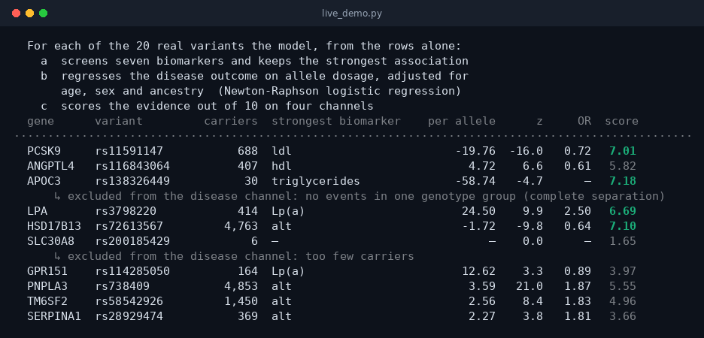
STEP 3 OF 9 · ASSOCIATION TESTING
Per-variant estimation across 210,000 observations
Each row is printed at the moment its own regression converges. This step produces the evidence on which the allocation decision is later made.
1
Biomarker screen
Seven markers are tested per variant — LDL, triglycerides, HDL, BMI, ALT, HbA1c and Lp(a) — and the strongest association is retained.
2
Disease model
Logistic regression of the clinical outcome on allele dosage, fitted by Newton-Raphson and adjusted for age, sex and ancestry.
3
Pre-specified exclusions
Fewer than 20 carriers, or zero events in a genotype group, and the disease channel is excluded with the reason reported.
PCSK9 — LDL CHOLESTEROL
−19.76 mg/dL
per allele, z = −16.0
APOC3 and SLC30A8 are excluded from the disease channel on screen, with the statistical reason stated, rather than reporting an unsupported estimate.

Slide 21
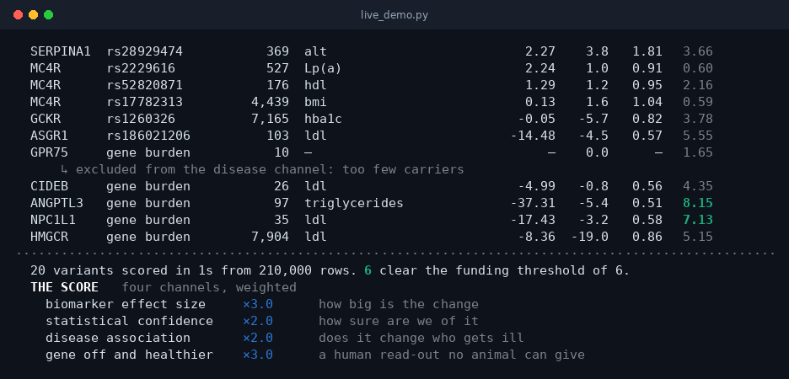
STEP 3 OF 9 · EVIDENCE SCORING FRAMEWORK
A transparent, four-channel composite score
The score is fully specified and auditable: four weighted components, each computed from the estimates above and displayed as it is derived.
1
Effect magnitude ×3
Standardised size of the biomarker shift per allele.
2
Statistical precision ×2
Confidence in that estimate, from its z statistic.
3
Clinical association ×2
Strength of the adjusted association with disease incidence.
4
Loss of function with benefit ×3
A naturally occurring human knockout with a favourable phenotype — a safety and efficacy signal unavailable from animal models.
MEETING THE EVIDENCE THRESHOLD
6 of 20
composite score ≥ 6.0
Twenty variants are scored in approximately one second from the 210,000 observations held in memory.

Slide 22
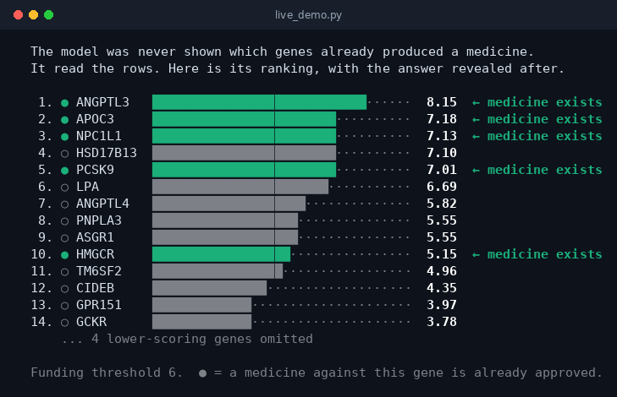
STEP 4 OF 9 · EXTERNAL VALIDATION
Ranking produced blind to the outcome
Eighteen genes are ranked on genetic evidence alone; the indicator of an existing approved medicine is introduced only after the ranking is fixed.
1
Ranking fixed first
Scores derive solely from the estimated associations; approval status enters no part of the computation.
2
Outcome then applied
A filled marker denotes a gene against which an approved medicine exists in current practice.
3
Result
Four of the five highest-ranked genes are drugged; HSD17B13, ranked fourth, is in clinical development.
PRECISION AT FIVE
4 of 5
top-ranked genes with an approved medicine
The ranking is evaluated against an outcome the procedure never observed, which is the basis for the validity claim that follows.

Slide 23
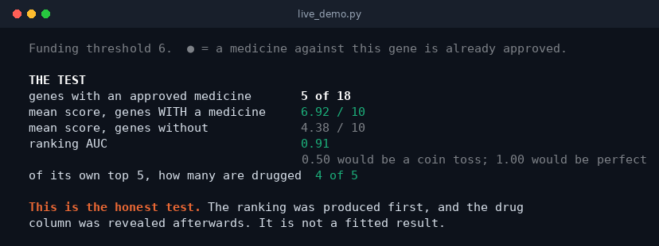
STEP 4 OF 9 · DISCRIMINATION
Discriminative performance: AUC = 0.91
The area under the ROC curve quantifies how well the score separates targets with an approved medicine from those without. No parameter was tuned to this outcome.
1
Genes with an approved medicine
mean composite score 6.92 / 10.
2
Genes without
mean composite score 4.38 / 10.
3
Blinding preserved in code
Approval status is read only after the ranking is fixed; this ordering is enforced in validate().
WHAT THE AUC MEANS
Take one gene at random that already has a medicine, and one that does not. The AUC is the probability that the model scores the first higher. A coin toss gives 0.50. This run gives 0.91.
AREA UNDER THE ROC CURVE
0.91
against 0.50 under random ordering
Validation 1 of 3. The remaining two — portfolio success probability and cost per approval — are reported in step 6.

Slide 24
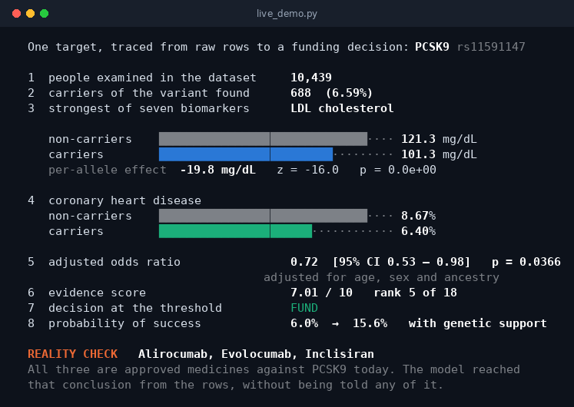
STEP 5 OF 9 · WORKED EXAMPLE
PCSK9: full derivation from observation to decision
A single target is traced through every stage of the pipeline, then compared with the medicines approved against that target in clinical practice.
1
Carrier ascertainment
688 carriers among 10,439 examined (6.59%), consistent with the published allele frequency.
2
Biomarker effect
101.3 mg/dL in carriers against 121.3 in non-carriers; −19.8 mg/dL per allele, z = −16.0.
3
Clinical outcome
Coronary heart disease 6.40% against 8.67%; adjusted odds ratio 0.72 [95% CI 0.53–0.98].
CLINICAL CORROBORATION
Alirocumab · Evolocumab · Inclisiran
three approved PCSK9 medicines, withheld from the procedure
Composite score 7.01/10, rank 5 of 18, classified as supported. Success probability rises from 6.0% to 15.6% under the published 2.6× uplift (Minikel et al., Nature 2024).

Slide 25
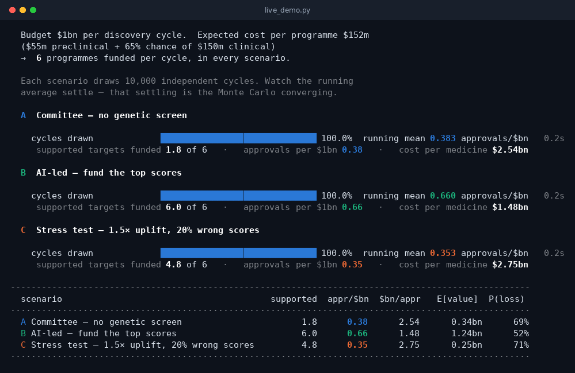
STEP 6 OF 9 · MONTE CARLO SIMULATION
Three allocation strategies under identical constraints
Budget, unit costs and portfolio size are held constant across arms. The selection rule is the only variable manipulated.
1
Arm A — committee
Six targets selected without genetic screening, representing the pre-genomic default.
2
Arm B — evidence-led
The six highest-scoring targets are funded.
3
Arm C — stress condition
A weaker 1.5× uplift with one score in five randomised.
ARM A — COMMITTEE
0.38
approvals per $1bn
ARM B — EVIDENCE-LED
0.66
approvals per $1bn
The running mean settles from 0.430 to 0.383 as draws accumulate; this convergence is observable on screen during execution.

Slide 26
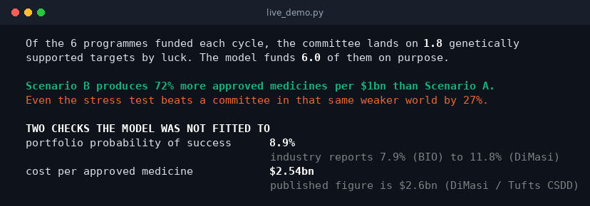
STEP 6 OF 9 · CONVERGENT VALIDITY
Two unfitted quantities reproduce published benchmarks
Two figures emerge as consequences of the cost and probability inputs, and both fall within independently published industry ranges.
1
Portfolio success probability
The comparator arm averages 8.9%, within the published range of 7.9% (BIO) to 11.8% (DiMasi).
2
Cost per approval
The baseline implies $2.54bn against a published estimate of $2.6bn (DiMasi, Tufts CSDD).
3
Neither was calibrated
Both quantities are consequences of the declared cost and probability inputs.
SUPPORTED TARGETS FUNDED
RELATIVE GAIN IN APPROVALS
1.8 → 6.0
+72%
of six per cycle, arm A → arm B
arm B over arm A, per $1bn
The comparator arm still selects 1.8 supported targets by chance, and the underlying biology rewards those selections. Modelling this correctly yields +72% rather than the inflated figure an asymmetric comparison would produce.
UNDER STRESS CONDITIONS
+27%
retained against a matched comparator
Validations 2 and 3 of 3. Neither quantity was used in calibration.

Slide 27
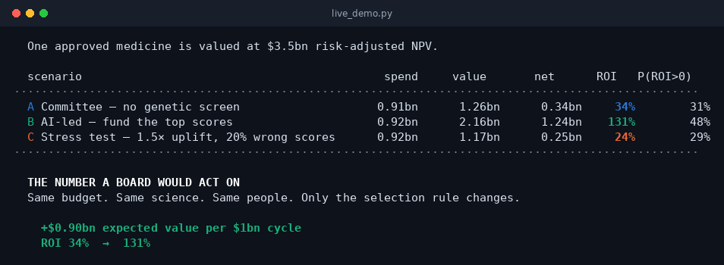
STEP 7 OF 9 · ECONOMIC EVALUATION
Expected value and return on investment
One approval is valued at $3.5bn risk-adjusted NPV. Expenditure is effectively identical across arms, so the difference is attributable to the selection rule alone.
1
Expenditure held constant
$0.91bn against $0.92bn; the selection rule imposes no additional cost.
2
Value created
Expected value rises from $1.26bn to $2.16bn per cycle.
INCREMENTAL EXPECTED VALUE
+$0.90bn
per $1bn discovery cycle
RETURN ON INVESTMENT
34% → 131%
arm A → arm B
PRODUCTIVITY
0.38 → 0.66
approvals per $1bn
Budget, scientific capability and organisational capacity are held constant; the intervention is the evidence-based selection rule alone.

Slide 28
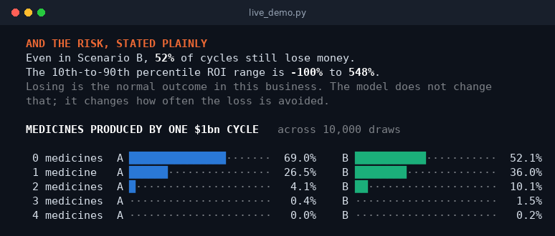
STEP 7 OF 9 · DISTRIBUTIONAL ANALYSIS
The full outcome distribution, not the mean alone
Central estimates conceal the dispersion that governs this industry. The downside is reported alongside the expected return, not after it.
1
Majority of cycles return a loss
In the evidence-led arm, 52% of $1bn cycles close below break-even.
2
Wide dispersion
The 10th-to-90th percentile return spans −100% to +548%.
3
Shift in the distribution
The probability of producing nothing falls from 69% to 52%, while the probability of two or more approvals approximately triples.
PROBABILITY OF ZERO APPROVALS
PROBABILITY OF TWO OR MORE
69% → 52%
4.5% → 11.8%
The approach shifts the probability distribution; it does not eliminate downside risk, and reporting both is a condition of the claim.

Slide 29
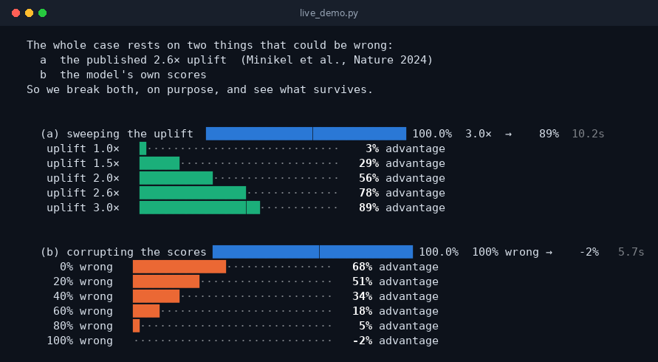
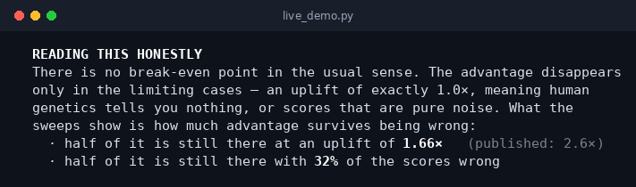
STEP 8 OF 9 · SENSITIVITY ANALYSIS
Robustness of the conclusion to its two key assumptions
Both assumptions on which the conclusion depends are varied systematically across their plausible range, and the surviving advantage is measured at each point.
1
Misspecification of the uplift
The advantage declines monotonically rather than collapsing, and reaches zero only at 1.0× — the case in which human genetic evidence carries no information.
2
Misclassification of the scores
With one score in five randomised, 51% of the advantage is retained; under complete randomisation it disappears, as expected.
FIFTY PER CENT OF THE EFFECT RETAINED AT
1.66× uplift
published estimate is 2.6×
OR AT
32% misclassification
of the model’s own evidence scores
No interior break-even point exists. The analysis instead reports the proportion of the advantage retained under substantial misspecification.

Slide 30
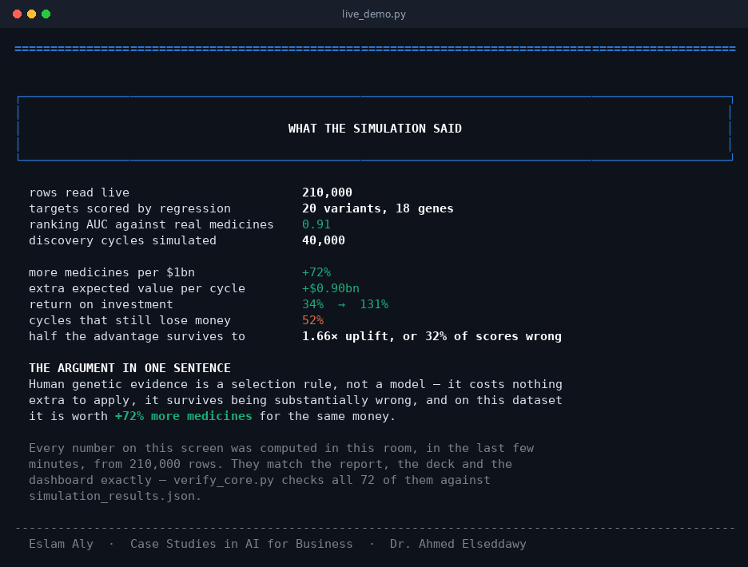
STEP 9 OF 9 · SUMMARY OF FINDINGS
Results of the live execution
Every quantity reported below was computed during this demonstration, from the source observations upward.
OBSERVATIONS INGESTED
210,000
in 44 seconds
DISCRIMINATION (AUC)
0.91
against 0.50 under chance
GAIN IN APPROVALS PER $1bn
+72%
and +$0.90bn expected value per cycle
CYCLES RETURNING A LOSS
52%
downside risk is not eliminated
verify_core.py re-executes the full pipeline and reconciles every reported figure against simulation_results.json: 70 checks, 0 discrepancies.

Slide 31
REPRODUCIBILITY STATEMENT
Independent replication in four commands
The demonstration is not a recording. It executes the same codebase that produced the written report, this presentation and the performance dashboard.
pip install numpy pandas openpyxl
three standard libraries; no network access, external service or proprietary dependency
python live_demo.py --notes
executes the nine steps with presenter annotations, pausing between each
python live_demo.py --sensitivity
adds step 8, the two-parameter sensitivity sweeps
python verify_core.py
re-executes the pipeline and reconciles 70 figures against simulation_results.json
VERIFICATION OUTPUT
DOCUMENTED REFERENCE LAYER
PASS 70 FAIL 0
18 genes · 20 variants · 45 sources
all reported figures reconcile across report, presentation and dashboard
participant-level data simulated from those published effect sizes
Eslam Aly · Case Studies in AI for Business · Dr. Ahmed Elseddawy · Smart Village Campus

Slide 32
Thank You

